Slide 1
Knowledge Base Questions
File created on: 12/11/2019 6:11:24 PM

Slide 2
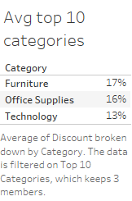

Slide 3
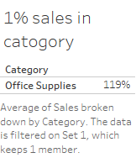

Slide 4
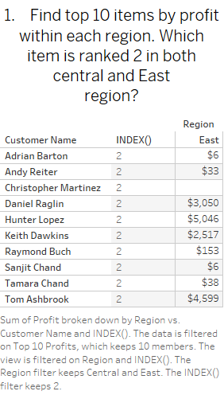

Slide 5
